Slide 1
ARTT 399
Critical Issues for Painters
Sept 18, 2017

Slide 2
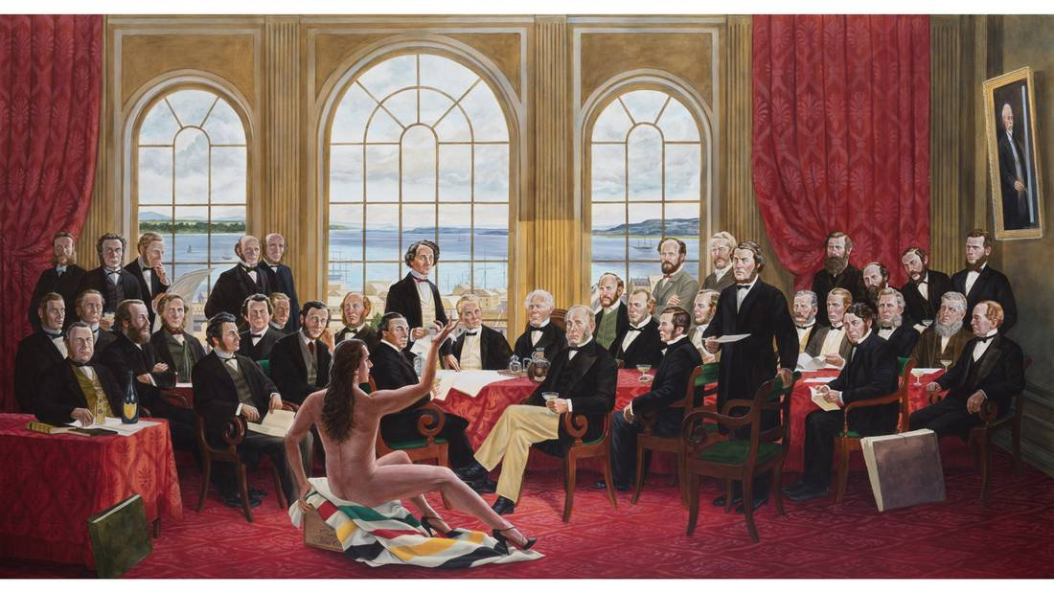
https://beta.theglobeandmail.com/news/national/canada-150/kent-monkman-shame-and-prejudice/article33515775/?ref=http://www.theglobeandmail.com&

Slide 3
https://www.youtube.com/watch?v=VGQ5J-_9r6c

Slide 4
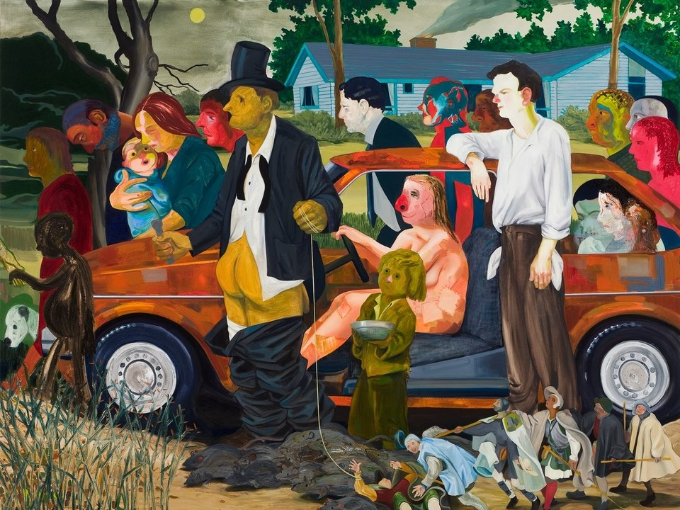

Slide 5
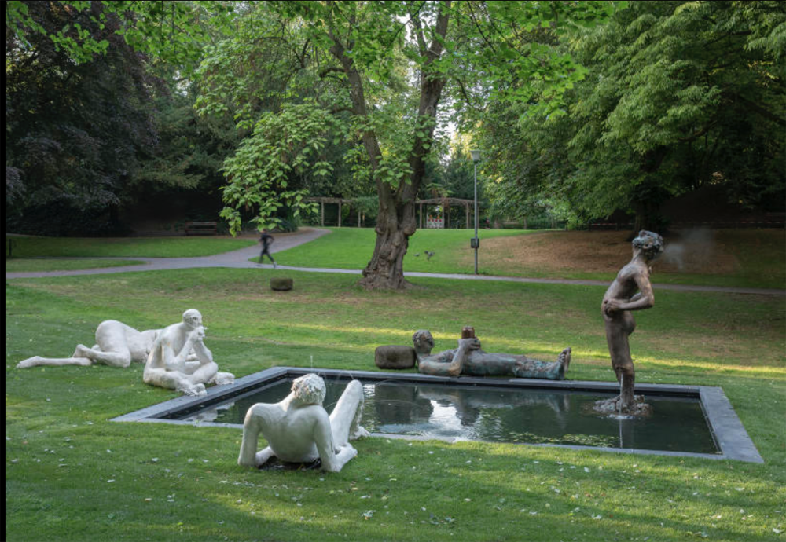

Slide 6
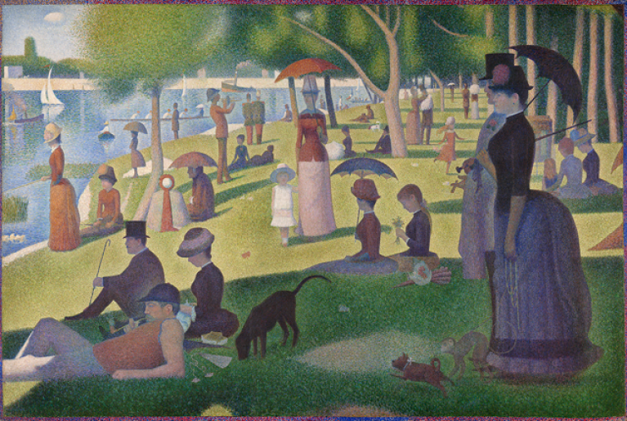

Slide 7
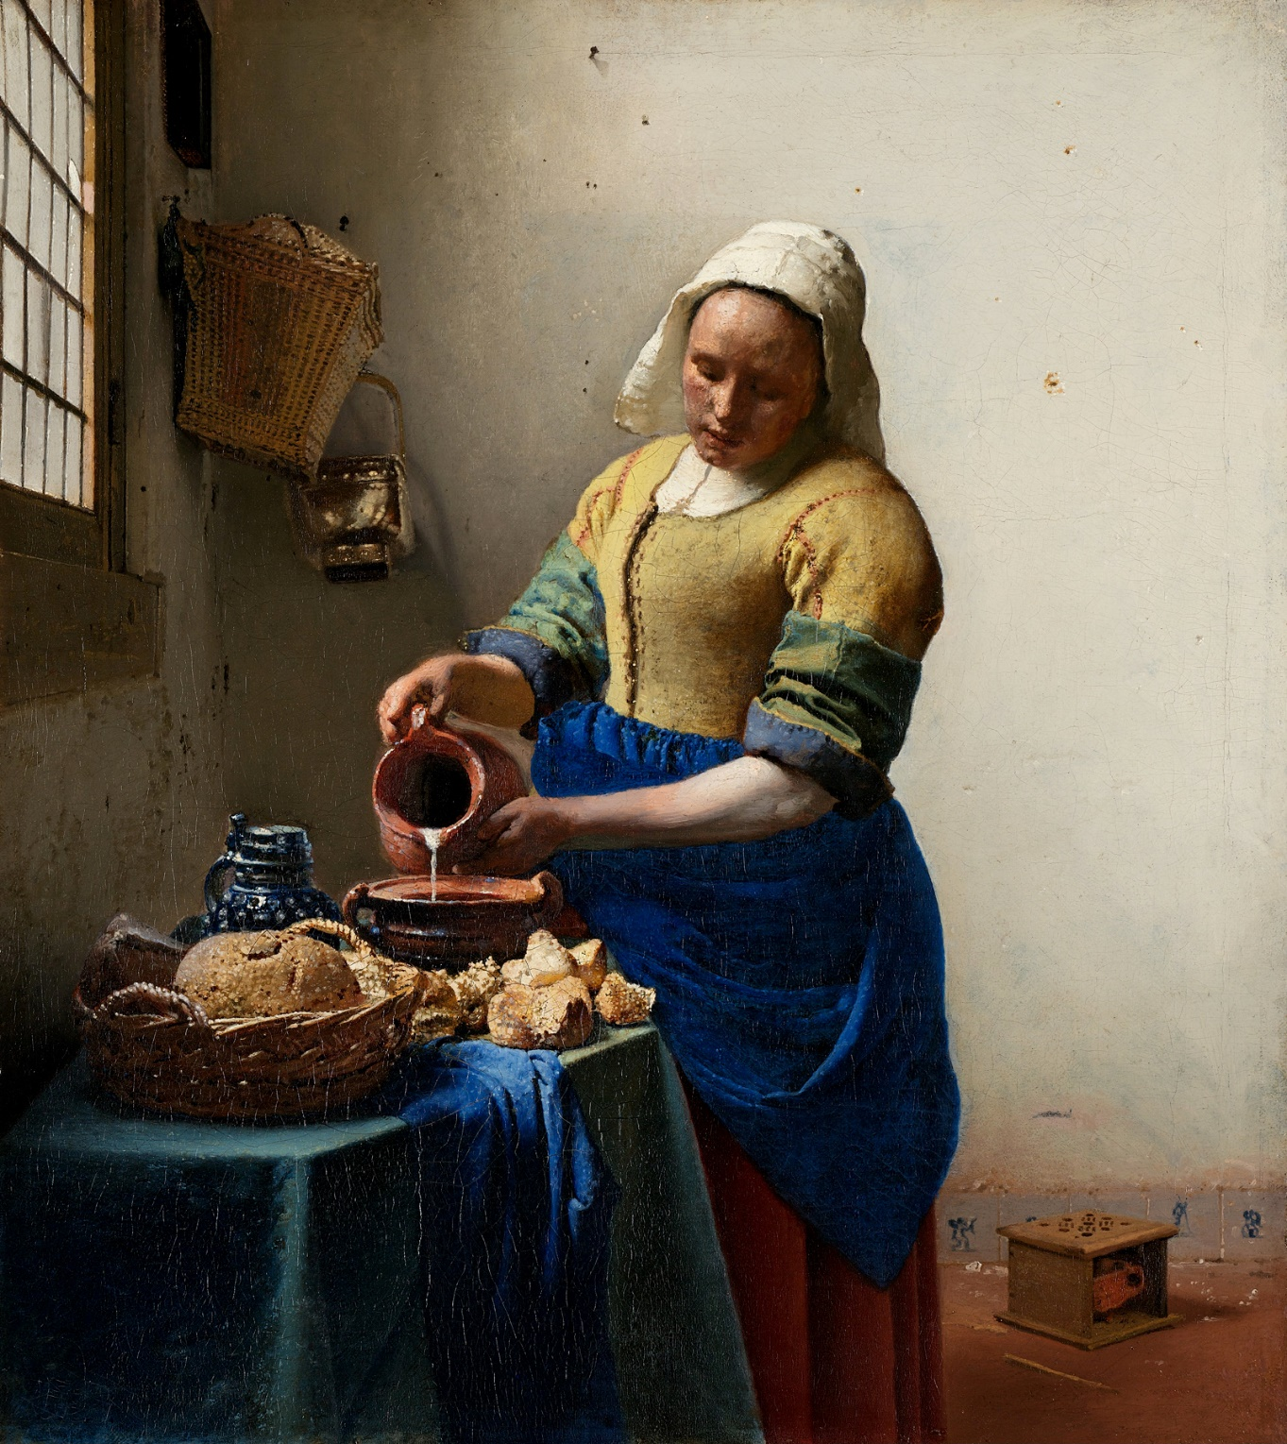

Slide 8
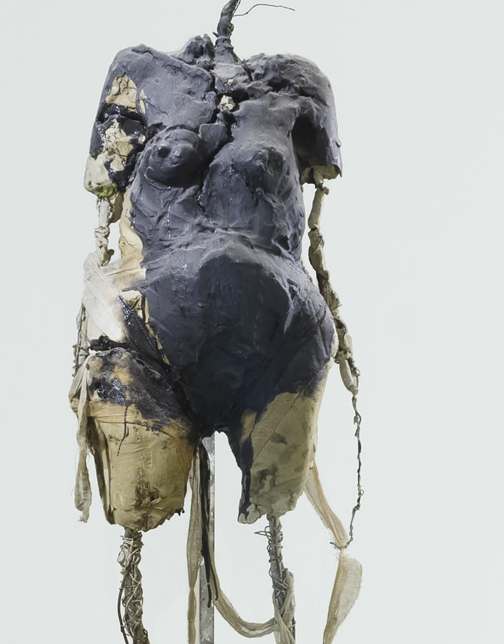

Slide 9


Slide 10


Slide 11


Slide 12
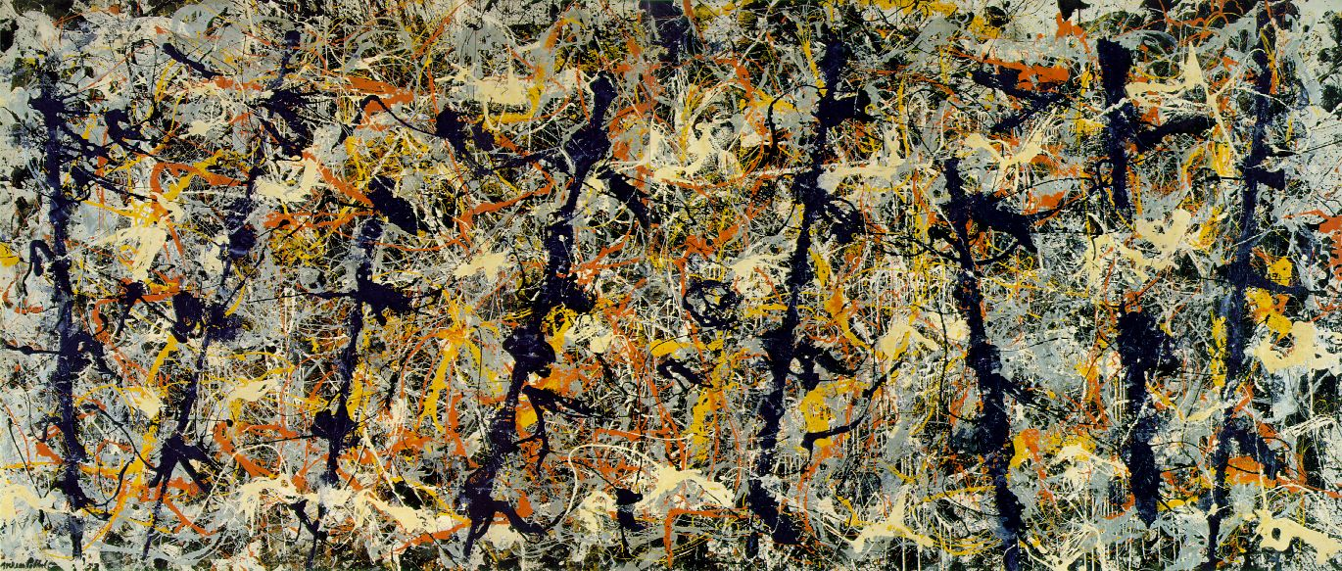

Slide 13
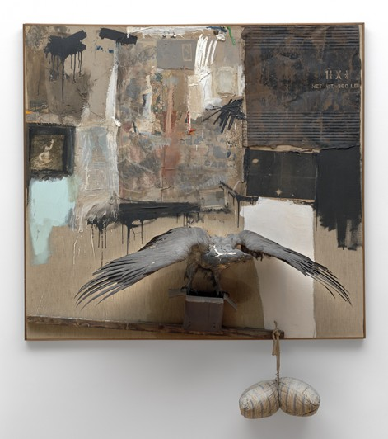

Slide 14
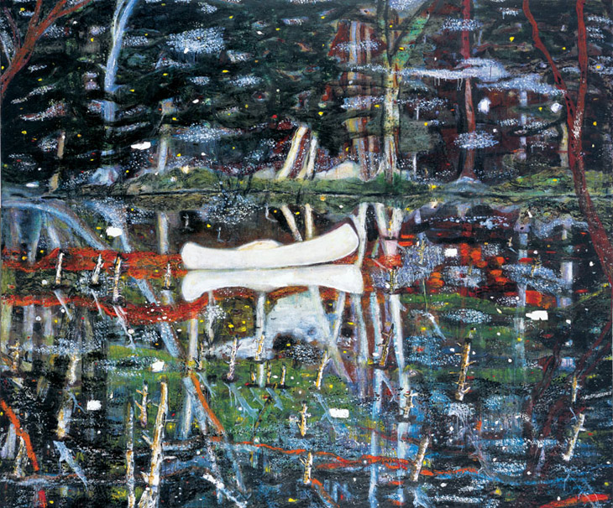

Slide 15


Slide 16
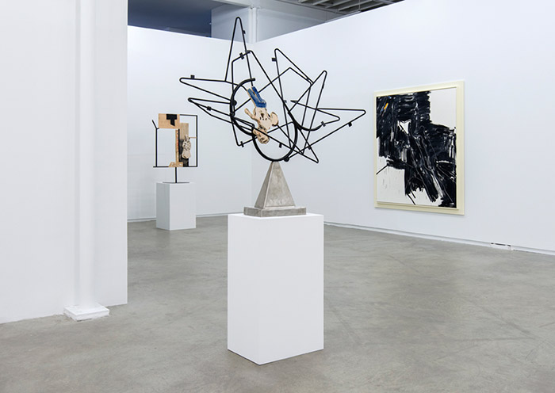

Slide 17
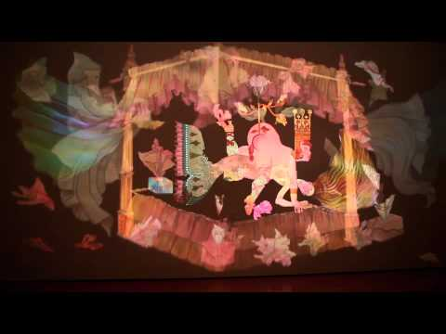
https://www.youtube.com/watch?v=BxvEvU4WcAM

Slide 18
https://www.youtube.com/watch?v=0ox0IYv1vjs

Slide 19
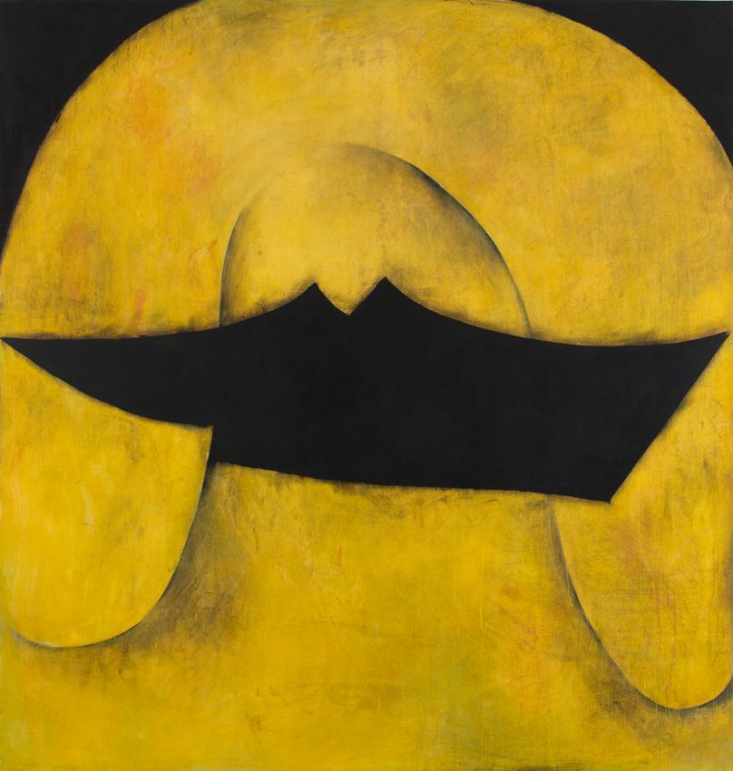

Slide 20
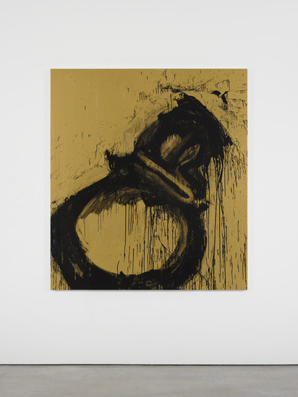

Slide 21
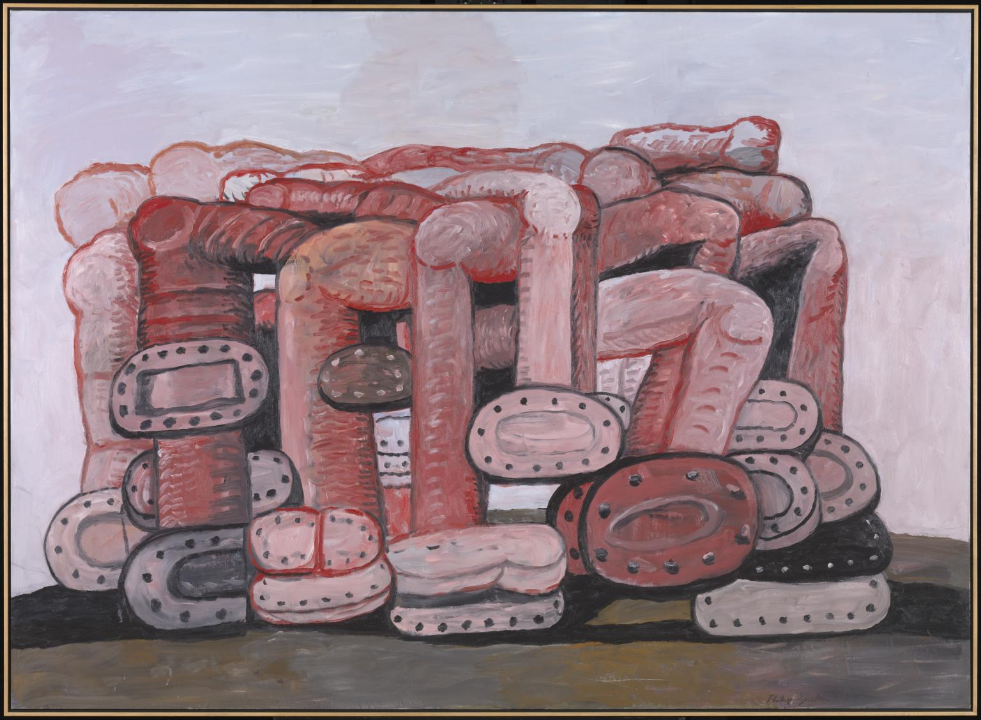

Slide 22
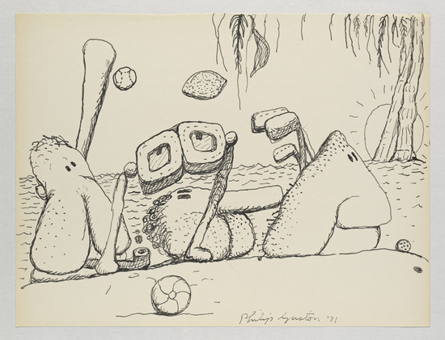

Slide 23


